Slide 1
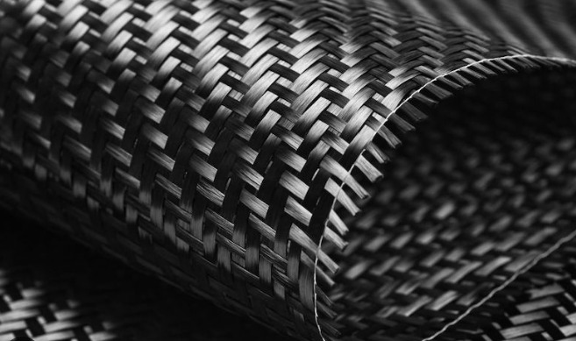
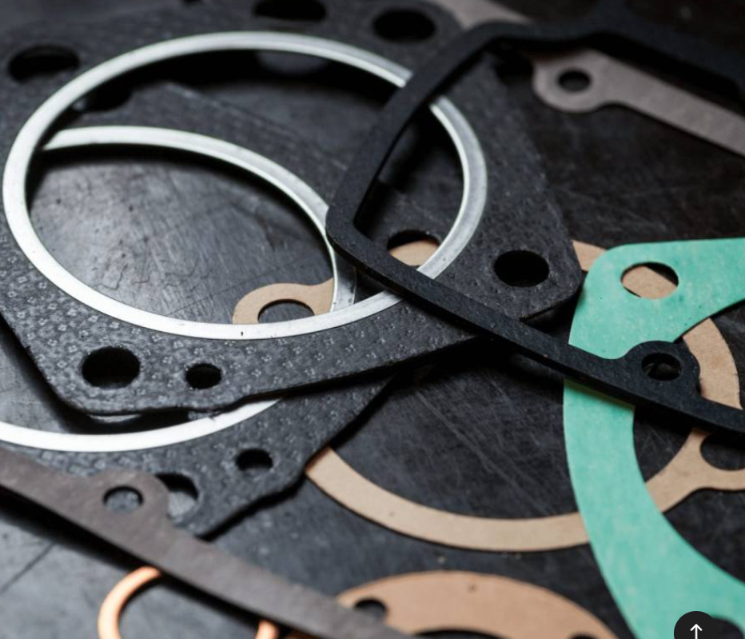
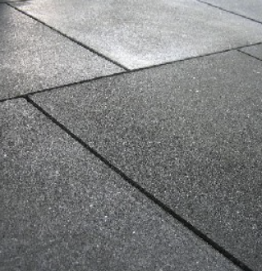
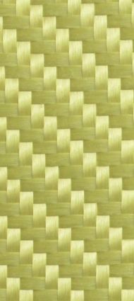
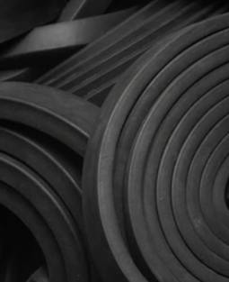
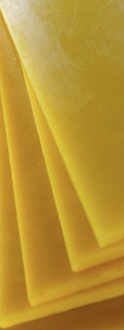
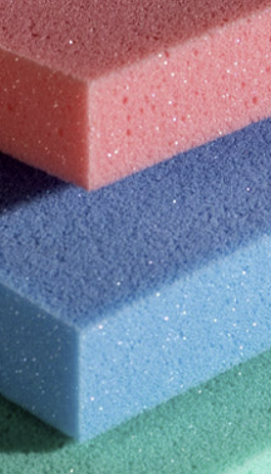

Rubber flooring
Carbon fibre
Rubber
Foam
Kevlar
Vulcolan
Gasket
AUTOMOTIVE
SOLUTION

Slide 2
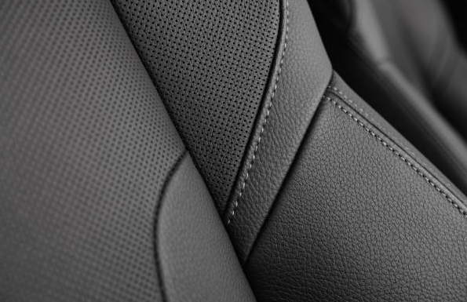
Automotive
Car interior

Slide 3
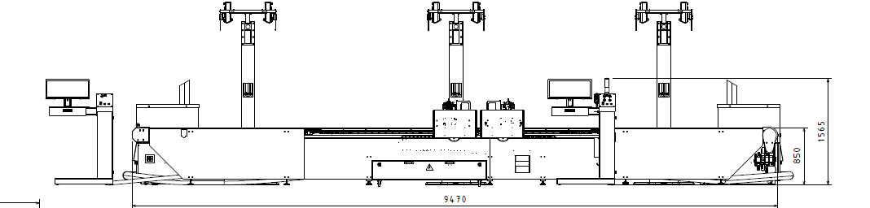
1°Solution
Flex 3026 2H B3
This solution is ok for large pieces. Car seats or deashborad.

Slide 4
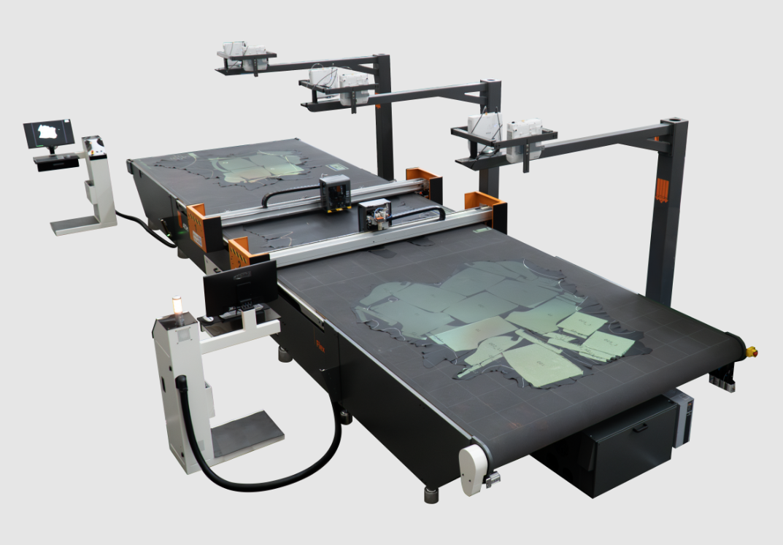
1°Solution
Flex 3026 2H B3
No Scanner
Interactive nesting
Positioning check on working area (opt)
Projection on unload area (opt)

Slide 5
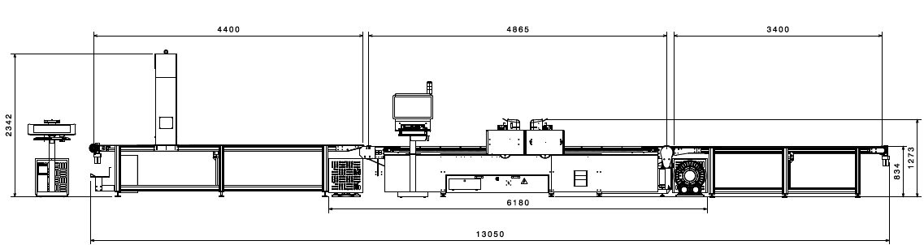
2°Solution
Flex 3026 2H B3
Three indipendent block with in line scanner. Solution proposted for a stearing wheel+upex on working and unloading area.

Slide 6
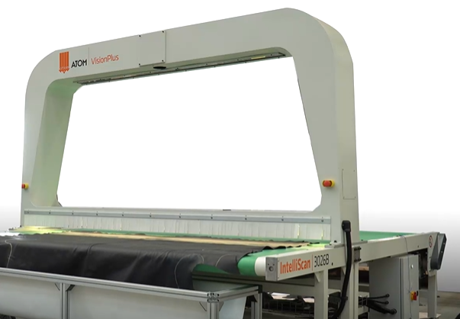
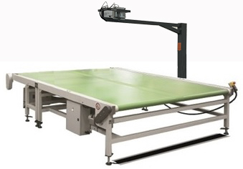
1°Solution
Flex 3026 2H B3
In line scanner
Automatic nesting or manual before cutting area
Positioning check on working area (opt)
Projection on unload area (opt)
Job manager (opt)
Nesting strategy (opt)
In line scanner
Indipendent unloading table

Slide 7
Rubber flooring
Carbon fibre
Rubber
Foam
Kevlar
Vulcolan
Gasket
THANKS

